Slide 1
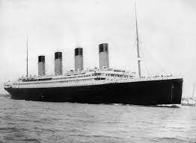
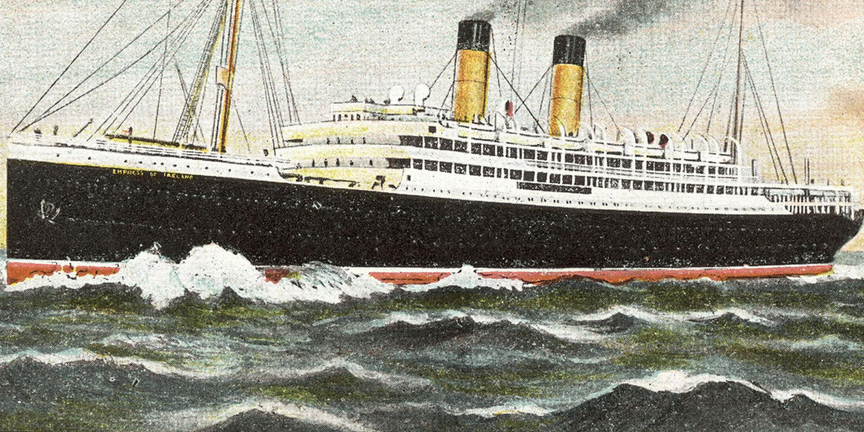
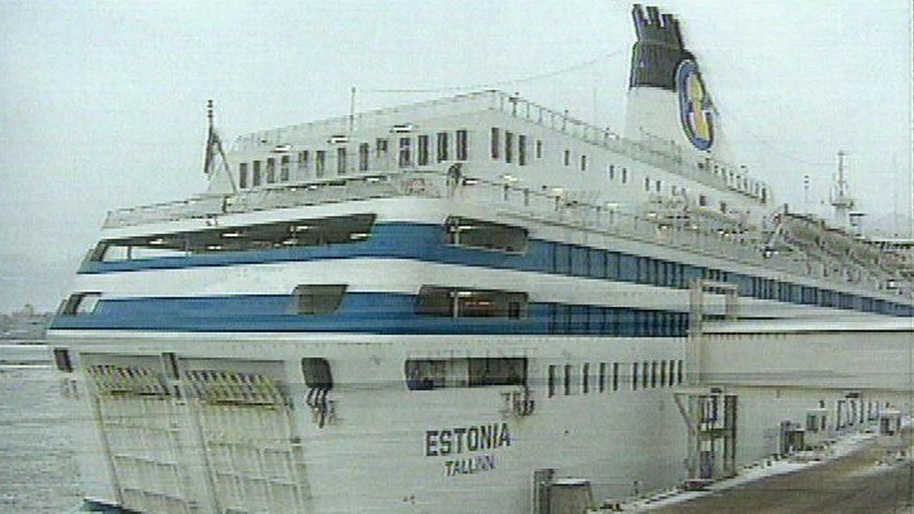
Project 4
Predicting Survivability of Passengers across Multiple Independent Maritime Crises
Matt Hill Walter Wilson Chang Jang Anthony Davey

Slide 2
Motivation
Predict survivability for a few of the deadliest maritime disasters
Create a generalized model for predicting survival of other disasters
ETL Process - the end-user can access
Build machine learning models - Supervised, Unsupervised, Deep Learning

Slide 3

Data Sources
CSV Data Sources – Kaggle & National Museums Liverpool
Empress of Ireland Passenger List – 1,469 Rows
Estonia Passenger List – 989 Rows
Titanic Dataset – 1,309 Rows
Testing Set – 418 Rows
Training Set – 891 Rows
Database Storage
Data Summary
All datasets contained
Survived (0 , 1) – Target
Full Name
Sex
Age
Empress of Ireland – missing crew age data

Slide 4
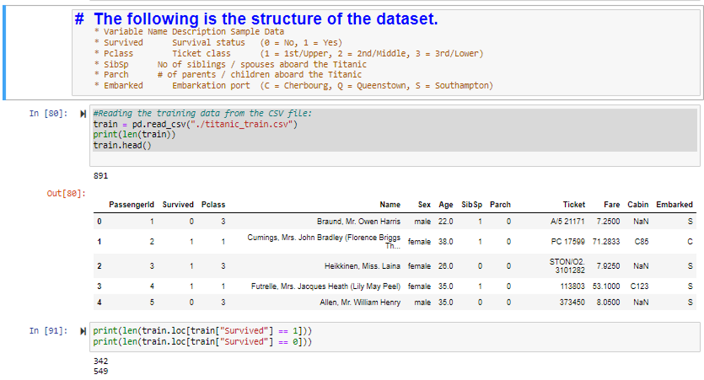
ETL: Titanic Dataset

Slide 5
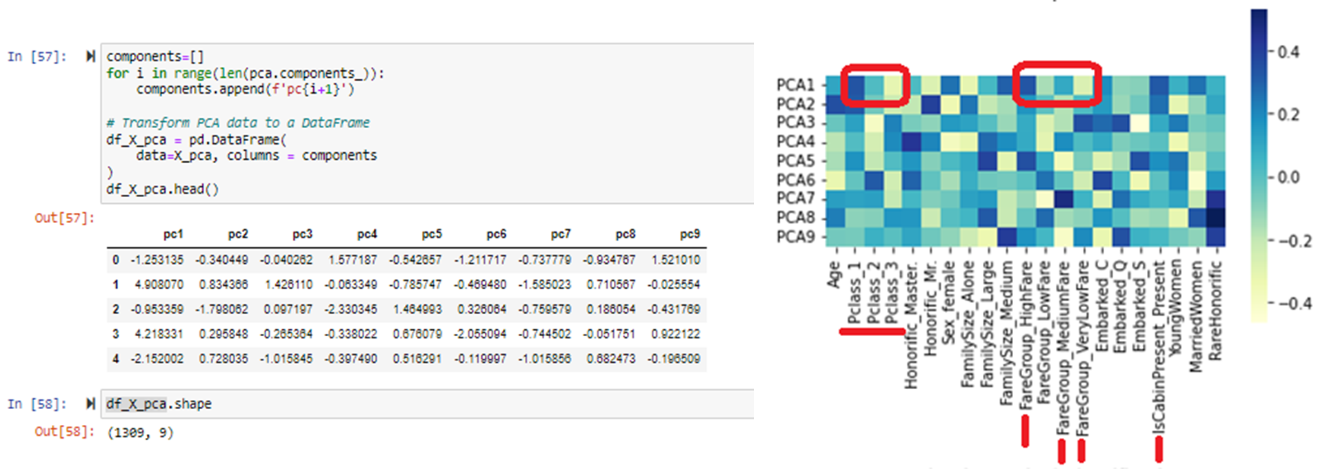
Principal Component Analysis

Slide 6
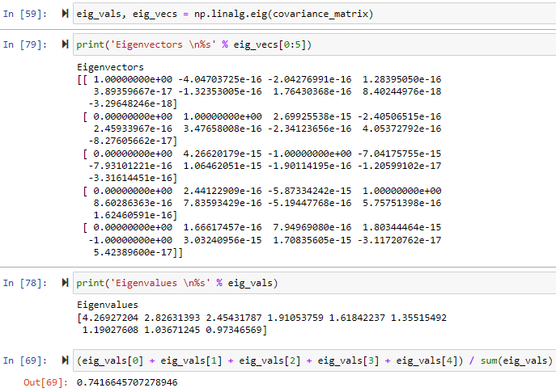
PCA: Eigenvector and Eigenvalue

Slide 7
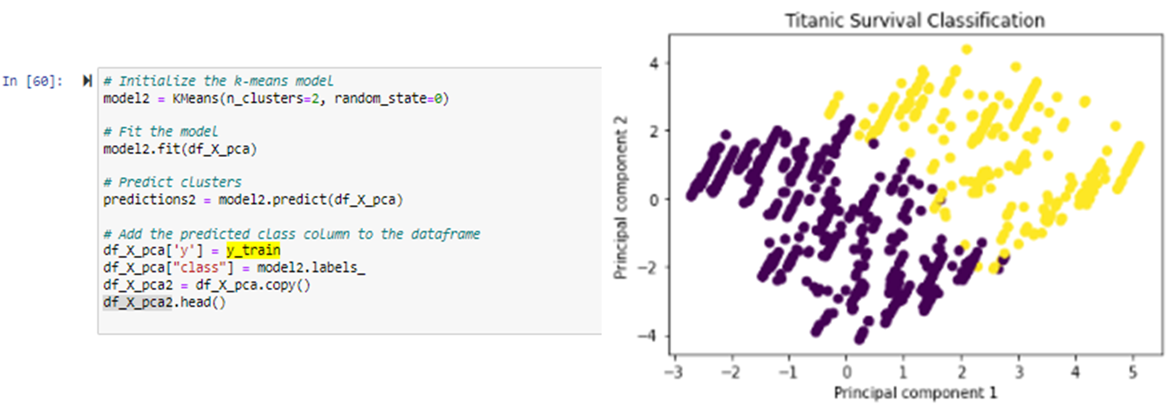
Model 1: Unsupervised K-Means Clustering

Slide 8
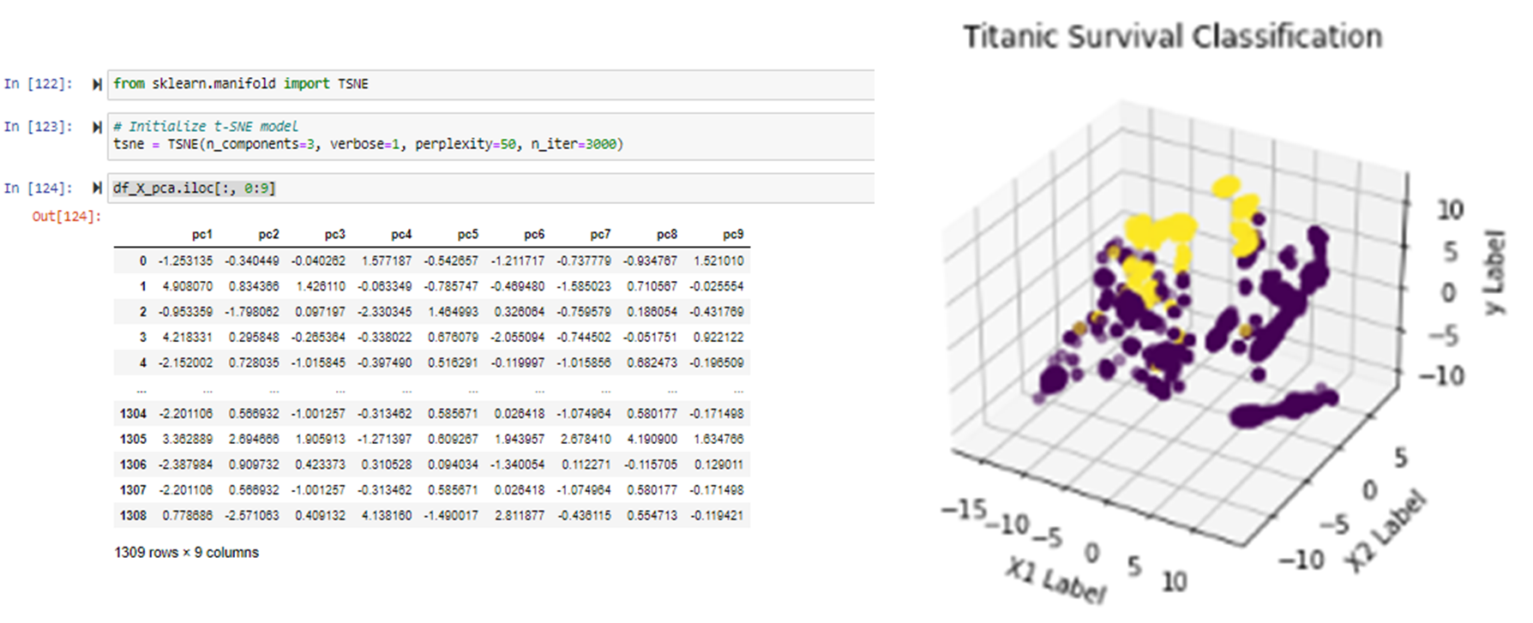
Model 2: Unsupervised T-SNE

Slide 9
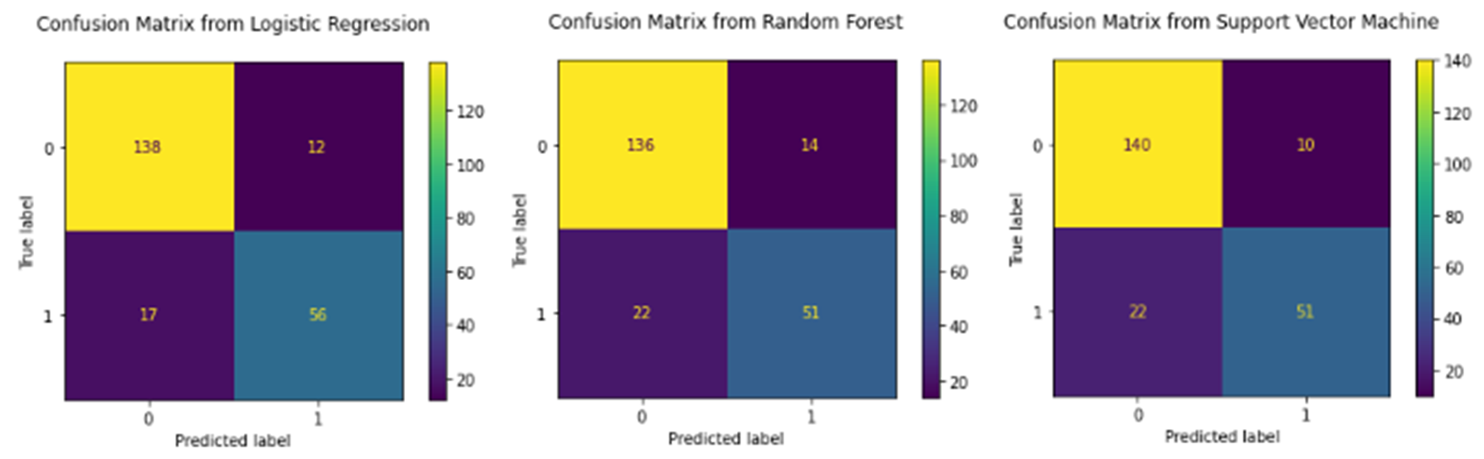
Model 3: Supervised ML (LR, RF, SVM)
TP + TN
TP + TN + FP + FN
Accuracy Score: 83%, 81%, 85%

Slide 10
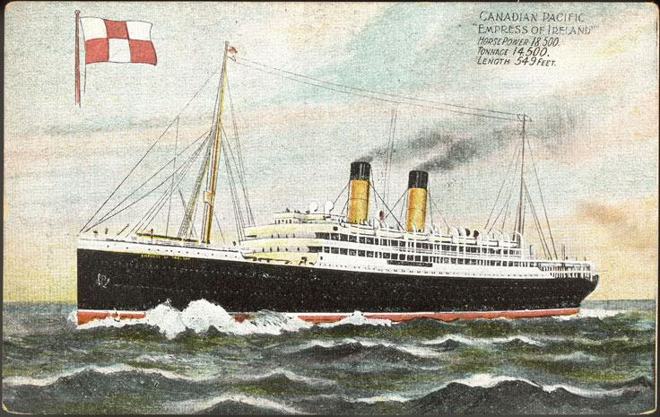
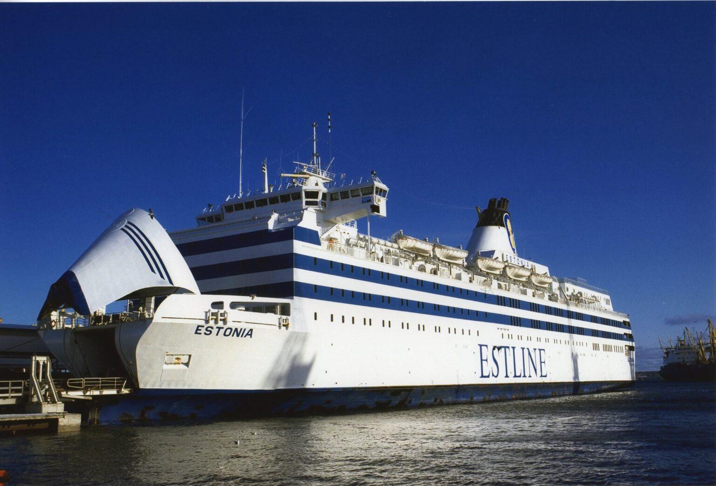
Further Investigations
Can we make generalized predictions for other maritime disasters?
Are models valid for predictions between disasters?

Slide 11
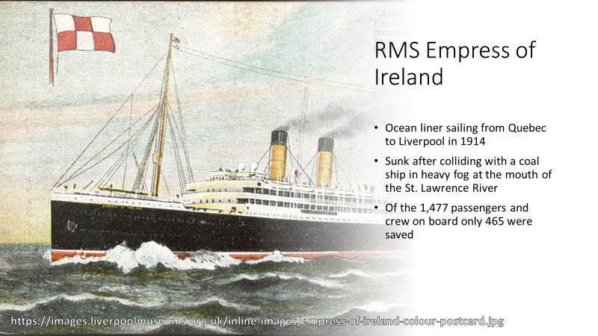

Slide 12
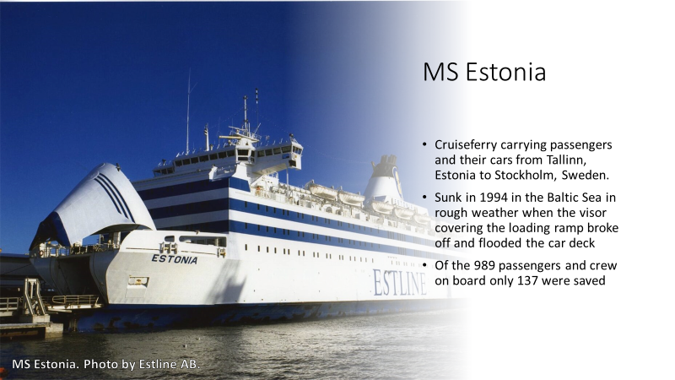

Slide 13
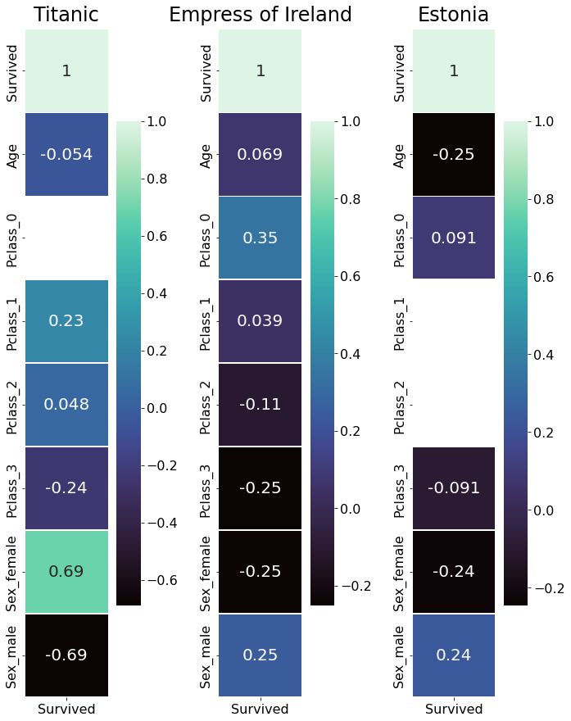
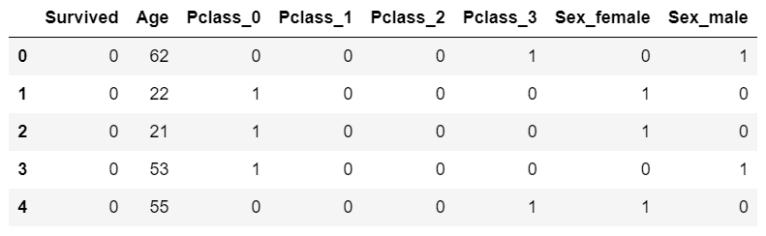
Formatting the Data
We used a stripped down version of the Titanic dataset with Pclass and sex formated as categroicals and Pclass_0 added to indicate crew.
Chart shows how each column of the datasets correlate with survival.

Slide 14
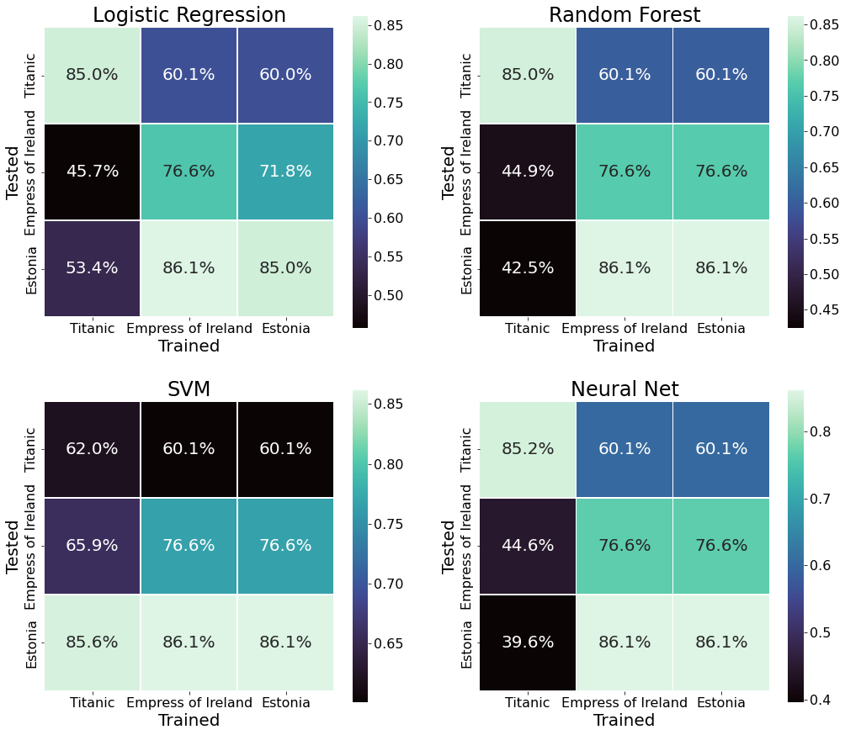
Training Models
Four models were created and trained on each of the datasets then tested on the other two.
Models trained on the Titanic were poor predictors of the Empress of Ireland and the Estonia.
Models trained on the Empress of Ireland and the Estonia performed nearly identically.
SVM (Support Vector Machine) did not fit well to the Titanic data at all.

Slide 15
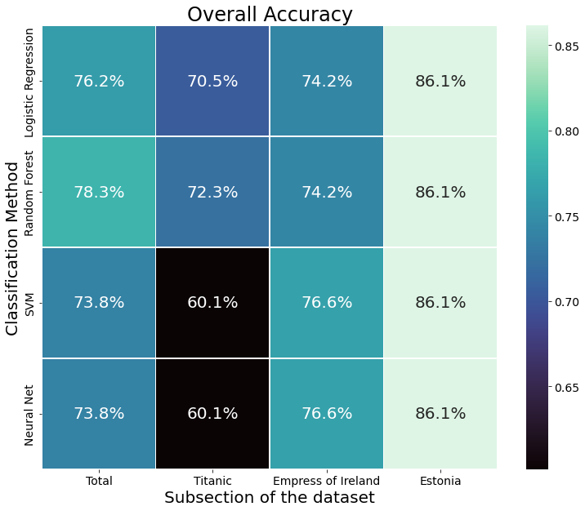
Training Models
Models were trained on a combined dataset of all three and tested on each sub-section of the data.
All four models were good predictors of the Estonia, okay predictors of the Empress of Ireland and overall dataset and poor predictors of the Titanic
Random Forest preformed best overall, predicting each subset with a fair amount of accuracy.

Slide 16
Conclusions
The Titanic seems to be an outlier among maritime disasters likely due to the fact that the Titanic sunk over the course of several hours allowing time for other patterns of survival to emerge.
In spite of the differences, models trained on all three datasets were still able to predict the survivors of the Titanic with a fair amount of accuracy, indicating that generalized models may be possible and may predict the outcome of disparate maritime disasters.

Slide 17
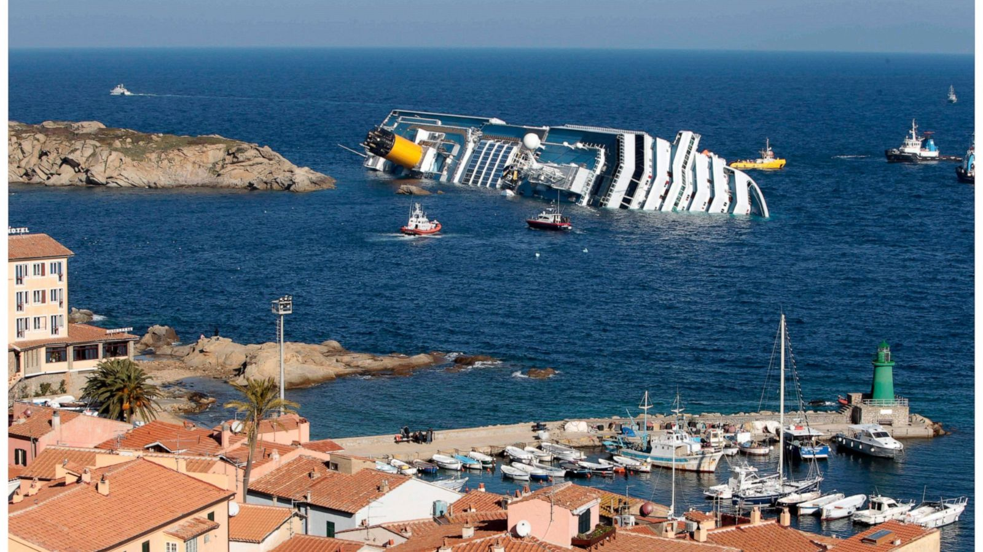
Survival Rate Prediction

Slide 18
Survival Rate Prediction Overview
Use some of the previously discussed models to make predictions about hypothetical victims of maritime disasters.
The data on these victims was randomly generated.
Compare the predicted survival rates to the actual statistics.
These statistics are sourced from a dataset containing survival rates of males and females, ages 0-80 from the year 1900-2010

Slide 19
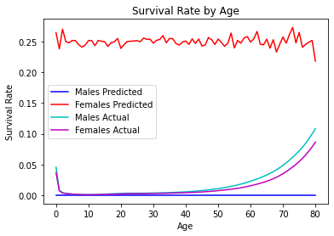
Random Forest Predictions
Started with the model that had the highest accuracy previously, the Random Forest, and used it to create predictions.
There was a very apparent flaw with the predictions that it yielded.

Slide 20
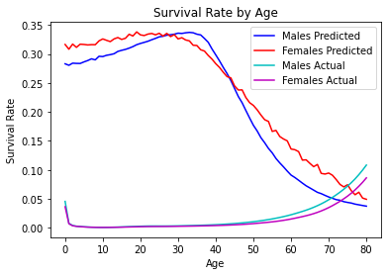
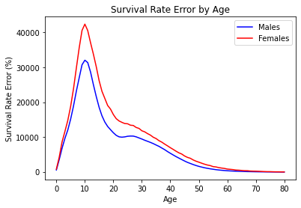
Neural Network: Age Breakdown
The issue with the male survivability was resolved with the predictions of this model.
However the error with the predictions is still extremely high.

Slide 21
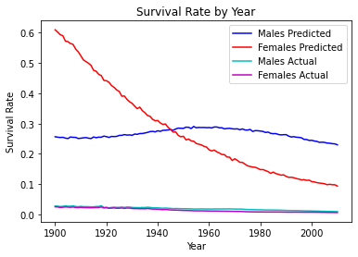
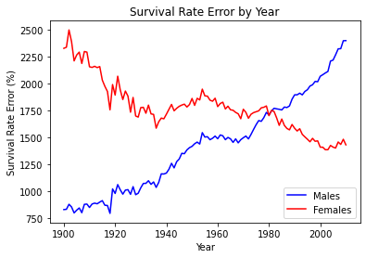
Neural Network: Yearly Breakdown
The magnitude of the error is significantly less but much too high to be usable.
It is probable that our data on actual disasters was too limited to make predictions with.

